Slide 1

:- SUBMITTED BY THE ELITE GROUP

Slide 2
OUR TEAM
ARYAN VIJAY LASURE
SAHIL SANJAY KADAM
SWARALI KRISHNAT KHOT
FAREEHA MUNNER MAJGAONKAR
SUDHAKAR RAMESH RATHOD
DILKASH DILAWAR MUKADAM
TRUPTI ASHOK KADAM

Slide 3
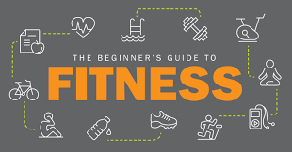
OBJECTIVES OF OUR SITE
The objective of a diet fitness project can be to promote and encourage healthy lifestyle habits that encompass both balanced nutrition and regular physical activity. The project aims to help individuals achieve their fitness goals, improve overall well-being, and develop sustainable habits for long-term health. It should provide personalized guidance, support, and education on nutrition, exercise, and behavior modification, empowering participants to make informed choices and adopt a healthier lifestyle. The ultimate goal is to positively impact participants' physical health, mental well-being, and quality of life.

Slide 4
WHY WE CHOOSE THIS PROJECT
Personal interest: If you have a passion for fitness and wellness, creating a fitness website can be a rewarding way to share your knowledge and help others achieve their health goals.
Industry demand: The fitness industry is constantly growing, and there is a high demand for online platforms that offer fitness tips, workout routines, nutrition advice, and more. Developing a fitness website can tap into this demand and potentially attract a significant audience.
Learning experience: Undertaking a website project can be an excellent learning opportunity, especially if you are interested in web development, design, and digital marketing. You can gain valuable skills and experience by working on a real-world project.
Community building: A fitness website can serve as a platform to build a community of like-minded individuals who share a common interest in fitness. This sense of community can foster engagement and loyalty among your website's users.
Monetization potential: If executed well, a fitness website can offer various monetization opportunities, such as advertising, affiliate marketing, online courses, or premium content subscriptions.
Positive impact: By providing valuable fitness information and resources, your website can positively impact people's lives by helping them lead healthier lifestyles, improve their fitness, and boost their overall well-being.
Flexibility and creativity: A fitness website allows you to be creative with content, design, and features. You can tailor the website to suit your vision and incorporate innovative ideas to make it stand out.

Slide 5
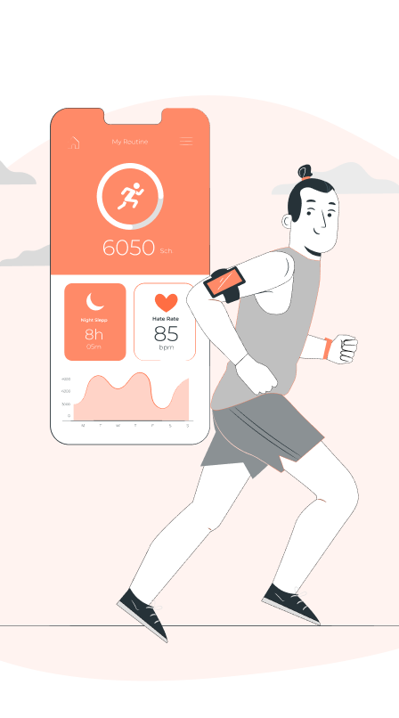
FEATURES OF WEBSITE
1. User-Friendly Interface
2. Comprehensive Health Information
3. Expert Contributors
4. Interactive Tools and Resources
5. Health News and Updates
6. Testimonials and Success Stories
7. Online Consultation and Support
8. Mobile Responsiveness
9. Privacy and Security
10. Social Media Integration
11. Multilingual Support
12. Health Blog and Newsletter
13. Online Booking and Appointments
14. Videos and Visual Content
15. Contact Information

Slide 6
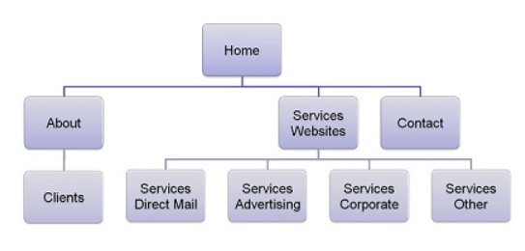
SITEMAP

Slide 7
TECHNOLOGIES USED
HTML
CSS
JAVASCRIPT

Slide 8
THANK YOU…

